Slide 1
HPC @ UA, running ib2d and IBAMR

Slide 2
Resources
https://github.com/fairyflies9/IBAMR-Tutorials
Examples and powerpoint slides
https://drive.google.com/drive/folders/1g0TIf-mRa3f2cOt2h8zztOmrhvMdZpuY?usp=sharing
Zoom recordings for old tutorials before Spring 2022
Recordings from Spring 2022:
https://github.com/fairyflies9/IBAMR-Tutorials

Slide 3
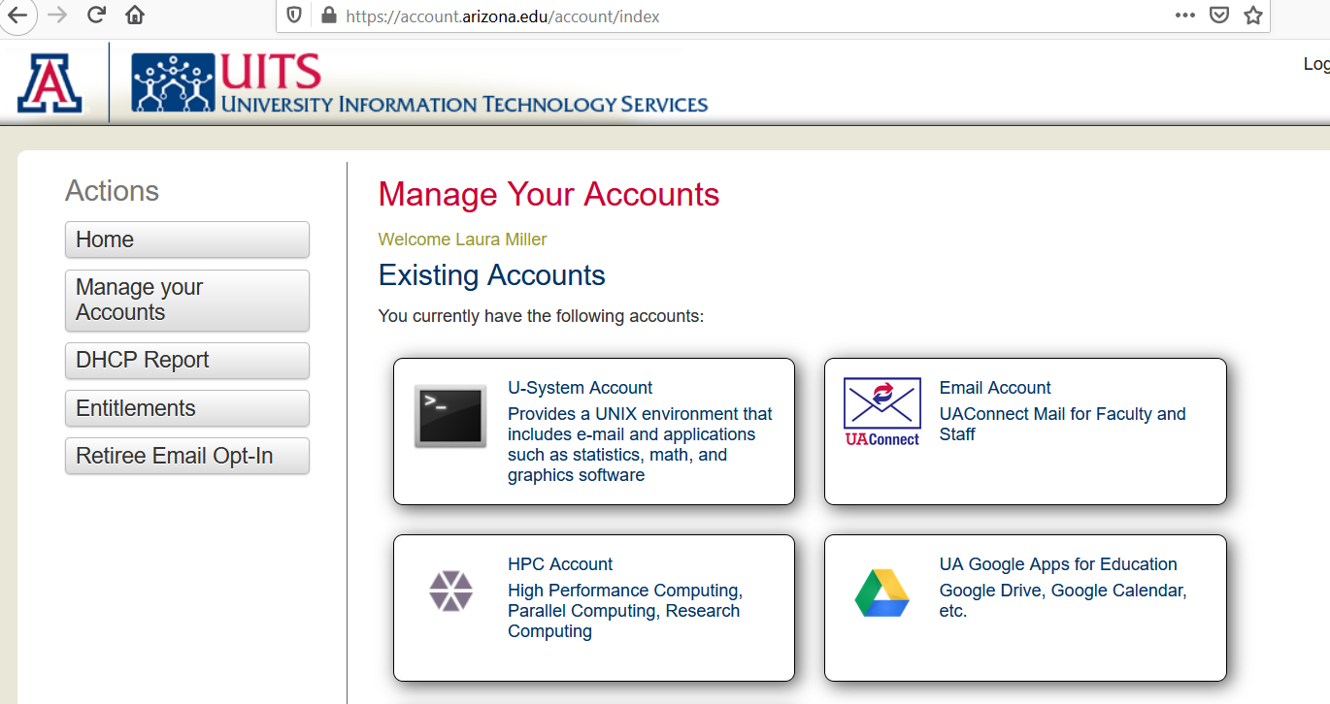
Services available
UA offers a variety of services, including a Unix environment and an HPC account. https://account.arizona.edu

Slide 4
Request the High Performance Computing Service
You must have an HPC account to use the Research Data Center services.
Log in at https://account.arizona.edu, go to Manage your Accounts, and choose High Performance Computing.
I will need to add you to my group.
You can find more information about getting started at HPC Documentation.
Note that there is a charge for simulations – please use the windfall partition unless you have permission for standard.

Slide 5
HPC at UA
You can use Jupyter notebooks, MATLAB, and other software through a web interface using Puma and ElGato.
To log into the web interface, go to https://OnDemand.hpc.arizona.edu

Slide 6
Vpn - often needed to log into UA remotely
Start a vpn session
Use the Cisco client
The server is vpn.arizona.edu
Logging in requires 2-step authentication. For the second password, type push (push notification) or phone (phone notification).
More information is here: UA Virtual Private Network (VPN) | Information Technology | University of Arizona

Slide 7
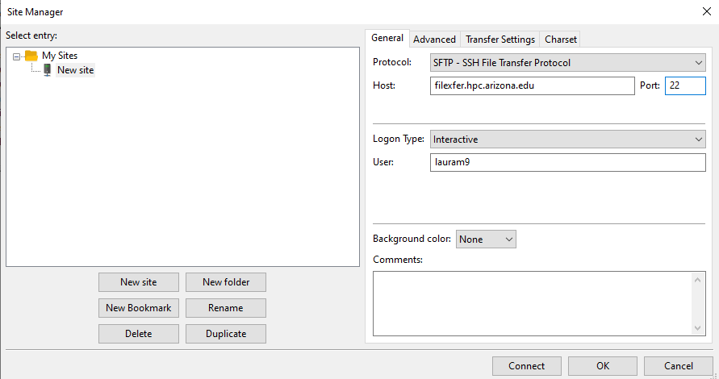
Moving files with Filezilla
In FileZilla, select the File menu
Select Site Manager
Select an existing site or select New Site to create a new connection
Enter the following information in the General tab:
Protocol: SFTP
Host: enter the server name
filexfer.hpc.arizona.edu
Logon Type: Interactive
User: Your NetID

Slide 8
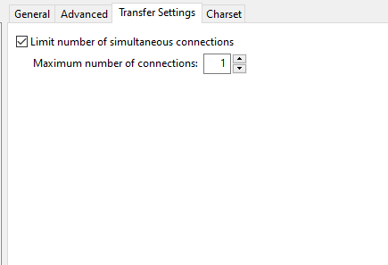
Moving files with Filezilla
Select the Transfer Settings tab
Select "Limit number of simultaneous connections"
Set simultaneous connections to: 1
Click Connect
In the first password box, enter your NetID password
In the second password box, type a 1 for Duo push or enter a passcode from your Duo device
You can now use FileZilla to transfer files to and from the shell server.

Slide 9
Moving files through the terminal - Using sftp
Open a terminal. You may want to cd to the directory where files you want to upload/download live. For example, cd Desktop if the files are on your Desktop. Otherwise, you need to know the path so that you can use that when you upload/download. For example C:/Users/lam9/Desktop
Enter Host Name netid@filexfer.hpc.arizona.edu.
Enter Port Number: 22.
Select SFTP.
Alternatively, in a terminal type sftp netid@filexfer.hpc.arizona.edu

Slide 10
Terminal - transferring files and folders
Once logged in, type puma or ocelot to use one of these servers.
Type ls and you will see the files in your current directory. Type pwd to see the current path. You may also cd to where you would like to upload or download files.
To upload a file from your computer to the cluster, type put file. To put an entire folder on the cluster, type put -r folder
If you want to get files / folders from the cluster to your computer, cd to where the folder lives and type get file or get -r folder

Slide 11
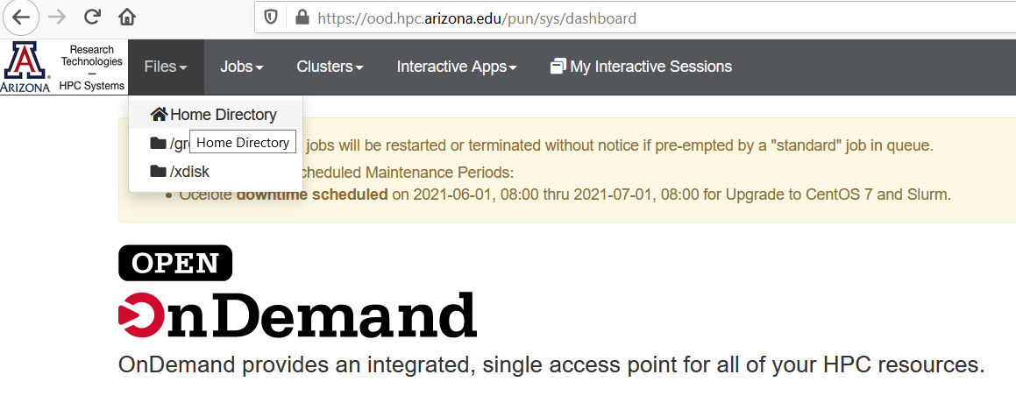
GUI - Moving files
Go to ood.hpc.arizona.edu
From the OpenOnDemand portal, select files and home directory

Slide 12
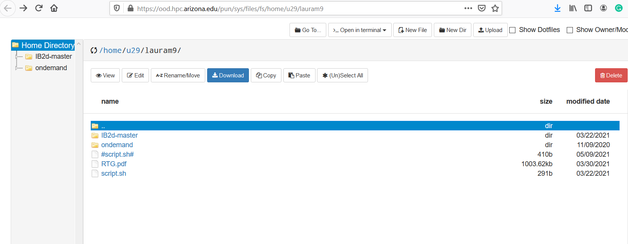
You may now upload/download through the web interface

Slide 13
Running ib2d on Puma / Ocelot
To upload a static version of ib2d onto your account.
I would start by making an unzipped version of Ib2d, and remove all data files from running simulations (viz_ib2d, hier_ib2d).
Option 1: Upload the folder into your directory on the cluster.
To log into the web interface, go to https://OnDemand.hpc.arizona.edu
From the OpenOnDemand portal, select files and home directory
You may now upload/download through the web interface using drag and drop from your computer.
Option 2: Use the terminal
You may want to first cd to the directory where ib2d lives. For example, if ib2d is on your desktop, cd C:/Users/lam9/Desktop
Now type sftp netid@filexfer.hpc.arizona.edu. You will need to use 2-step authentication again.
To put the entire ib2d folder in your home directory, type put -r ib2d
If you did not cd to the folder where ib2d lives, you need to type put -r /Path/to/ib2d

Slide 14
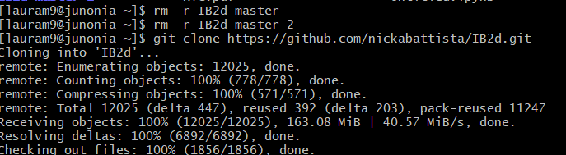
Better Option: Use git on your HPC account to get and update ib2d
To clone ib2d onto your account
Type git clone https://github.com/nickabattista/IB2d.git
To update ib2d
Cd into the ib2d folder
Type git pull origin master
Tutorials on git from the command line
https://git-scm.com/docs/gittutorial
Screenshot where I removed my old versions of ib2d and used git clone:

Slide 15

A separate folder for your ib2d simulations
It’s a good idea to run your ib2d simulations outside of the ib2d-master folder.
This makes it easy to update ib2d.
You can also store simulation data in a temporary folder.
To get the examples to work, you need to add the path to IBM_Blackbox to your main2d file.
Cd to where IBM_Blackbox lives.
Type pwd to get the working directory - /home/u29/lauram9/IB2d/matIB2d/IBM_Blackbox
In main2d.m
addpath('../IBM_Blackbox/','../../IBM_Blackbox/','../../../IBM_Blackbox/','.././../../IBM_Blackbox/');
Change to (my example, your path will be different)
addpath('/home/u29/lauram9/IB2d/matIB2d/IBM_Blackbox')

Slide 16
Running ib2d
There is a tutorial on how to run MATLAB through the command line
https://public.confluence.arizona.edu/display/UAHPC/Using+Matlab
We will submit the job using a script. A sample script is in this folder.
https://drive.google.com/file/d/17ocdeTnpdIf_vHHj2BlHLU4pF6Q_I5p_/view?usp=sharing
Open a terminal on your computer
Type ssh netid@hpc.arizona.edu
Type puma/ocelot to work on this cluster.
cd into the directory where the example is that you want to run
Be sure myscript.sh is in this folder
Type sbatch myscript.sh
To check the job, type squeue -unetid
This will show the job as pending or running. If nothing comes up, then you have no code that is running.

Slide 17
SLURM submission script
#!/bin/bash
# --------------------------------------------------------------
### PART 1: Requests resources to run your job.
# --------------------------------------------------------------
### Optional. Set the job name
#SBATCH --job-name=hello_world
### Optional. Set the output filename.
### SLURM reads %x as the job name and %j as the job ID
#SBATCH --output=%x-%j.out
### REQUIRED. Specify the PI group for this job
#SBATCH --account=<PI GROUP>
### Optional. Request email when job begins and ends
### SBATCH --mail-type=ALL
### Optional. Specify email address to use for notification
### SBATCH --mail-user=<YOUR NETID>@email.arizona.edu
### REQUIRED. Set the partition for your job.
#SBATCH --partition=standard
### REQUIRED. Set the number of cores that will be used for this job.
#SBATCH --ntasks=1
### REQUIRED. Set the number of nodes
#SBATCH --nodes=1
### REQUIRED. Set the memory required for this job.
#SBATCH --mem=1gb
### REQUIRED. Specify the time required for this job, hhh:mm:ss
#SBATCH --time=00:01:00

Slide 18
SLURM submission script continued
# --------------------------------------------------------------
### PART 2: Executes bash commands to run your job
# --------------------------------------------------------------
### Load required modules/libraries if needed
module load gnu/5.4.0
### change to your script’s directory
cd ~/hello_world
### Run your work
./hello_world
sleep 10
https://public.confluence.arizona.edu/display/UAHPC/Puma+Quick+Start#PumaQuickStart-WritingaSLURMSubmissionScript

Slide 19
myscript.sh
#!/bin/bash
#SBATCH --job-name=Lauras_job
#SBATCH --ntasks=1
#SBATCH --mem=16gb
#SBATCH --time=04:00:00
#SBATCH --partition=windfall
module load matlab
matlab -nodisplay -nosplash < main2d.m

Slide 20
Download data and book keeping
To download the results. Use the web interface or sftp, cd to where viz_IB2d lives, and type get -r viz_IB2d
To save space on the cluster, now remove this data. Delete in the web interface or type rm -r viz_IB2d

Slide 21
Running IBAMR
We have a new install of IBAMR that in the /groups/lauram9 folder on the cluster.
Old version, IBFE does not work.

Slide 22
IBAMR Tutorials
Tutorials on github with examples from UNC
Power point slides and code at https://github.com/fairyflies9/IBAMR-Tutorials
Zoom videos of old tutorials and other materials
https://drive.google.com/drive/folders/1g0TIf-mRa3f2cOt2h8zztOmrhvMdZpuY?usp=sharing
I’ve started a new folder for UA examples here:
IBAMR-Tutorials/AZ-Examples/IBFE-UA-Example-2DTriangle at master · fairyflies9/IBAMR-Tutorials · GitHub
I will keep adding new examples over the coming weeks and will start zoom tutorials next week.

Slide 23
Updating examples from UNC
The path needs to be changed in the makefile.
IBAMR_SRC_DIR = /contrib/lauram9/ibamr/0.7.1/include/IBAMR
IBAMR_BUILD_DIR = /contrib/lauram9/ibamr/IBAMR-0.7.1
LIBSNEW = $(LIBS) -lnetcdf -lcurl
*These directories are for the old IBAMR install where IBFE does not work. I will add info for the new paths soon.
The new installation where IBFE works is as follows:
IBAMR_SRC_DIR = /groups/lauram9/ib10/ibamr/IBAMR
IBAMR_BUILD_DIR = /groups/lauram9/ib10/ibamr/ibamr-objs-opt
LIBSNEW = $(LIBS) -lnetcdf -lcurl

Slide 24
Updating examples from UNC
There is a small change needed in the main file for IBFE examples.
Comment out the AutoPtr below and replace with std::unique_ptr
//AutoPtr<ExodusII_IO> exodus_io(uses_exodus ? new ExodusII_IO(mesh) : NULL);
std::unique_ptr<ExodusII_IO> exodus_io(uses_exodus ? new ExodusII_IO(mesh) : NULL);
There may be other changes needed, but this is the only one I’ve encountered so far

Slide 25
SLURM submission script for IBAMR
#!bin/bash #SBATCH --job-name=IBAMR-test
#SBATCH --ntasks-per-node=16
#SBATCH --nodes=1
#SBATCH --time=04:00:00
#SBATCH --partition=windfall
#SBATCH --output IBAMR2D.out
mpirun ./main2d input2d

Slide 26
Data storage
IB data is large, and I have created a new temporary space.
The path to this folder is /xdisk/lauram9
Permanent space at /groups/lauram9 – 500 GB, currently almost full.
I suggest that you put your ib2d and IBAMR simulation folders here.
Update the paths for ib2d or ibamr in main2d / makefile.
Run your simulation from these folders / write viz data here.
Download your data in a timely manner.
Delete files regularly
rm –r my_ib_sim_folder

